Slide 1
VLSM and CIDR
Routing Protocols and Concepts – Chapter 6

Slide 2
Objectives
Compare and contrast classful and classless IP addressing.
Review VLSM and explain the benefits of classless IP addressing.
Describe the role of the Classless Inter-Domain Routing (CIDR) standard in making efficient use of scarce IPv4 addresses

Slide 3
Introduction
Prior to 1981, IP addresses used only the first 8 bits to specify the network portion of the address
In 1981, RFC 791 modified the IPv4 32-bit address to allow for three different classes
IP address space was depleting rapidly
  the Internet Engineering Task Force (IETF) introduced Classless Inter-Domain Routing (CIDR)
      CIDR uses Variable Length Subnet Masking (VLSM) to help conserve address space.
        -VLSM is simply subnetting a subnet

Slide 4
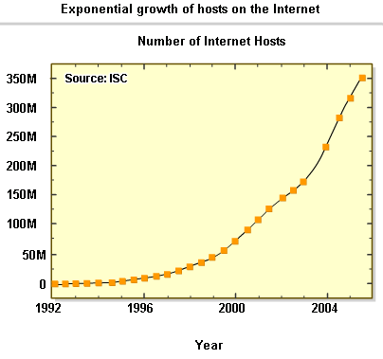
Classful and Classless IP Addressing
Classful IP addressing
As of January 2007, there are over 433 million hosts on internet
Initiatives to conserve IPv4 address space include:
-VLSM & CIDR notation (1993, RFC 1519)
-Network Address Translation (1994, RFC 1631)
-Private Addressing (1996, RFC 1918)

Slide 5
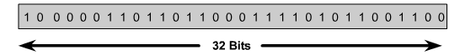

Classful and Classless IP Addressing
The High Order Bits
These are the leftmost bits in a 32 bit address

Slide 6
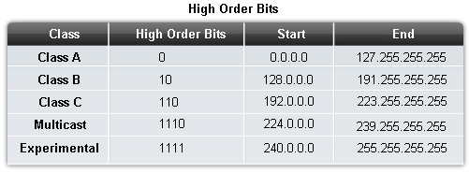
Classful and Classless IP Addressing
Classes of IP addresses are identified by the decimal number of the 1st octet
Class A address begin with a 0 bit
Range of class A addresses = 0.0.0.0 to 127.255.255.255
Class B address begin with a 1 bit and a 0 bit
Range of class B addresses = 128.0.0.0 to 191.255.255.255
Class C addresses begin with two 1 bits & a 0 bit
Range of class C addresses = 192.0.0.0 to 223.255.255.255.

Slide 7
Classful and Classless IP Addressing
The IPv4 Classful Addressing Structure (RFC 790)
An IP address has 2 parts:
-The network portion
Found on the left side of an IP address
-The host portion
Found on the right side of an IP address

Slide 8
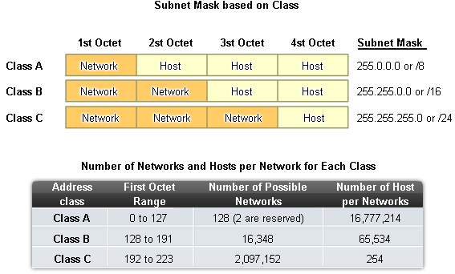
Classful and Classless IP Addressing

Slide 9
Classful and Classless IP Addressing
Purpose of a subnet mask
  It is used to determine the network portion of an IP address

Slide 10
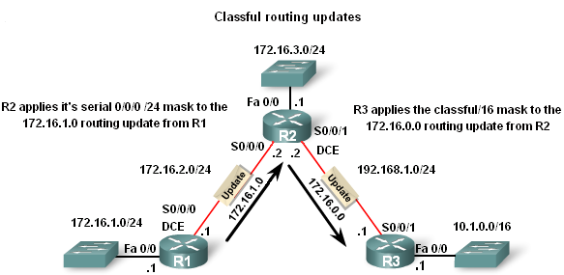
Classful and Classless IP Addressing
Classful Routing Updates
-Recall that classful routing protocols (i.e. RIPv1) do not send subnet masks in their routing updates The reason is that the Subnet mask is directly related to the network address

Slide 11
Classful and Classless IP Addressing
Classless Inter-domain Routing (CIDR – RFC 1517)
    Advantage of CIDR :
-More efficient use of IPv4 address space
-Route summarization
    Requires subnet mask to be included in routing update because address class is meaningless
Recall purpose of a subnet mask:
-To determine the network and host portion of an IP address

Slide 12
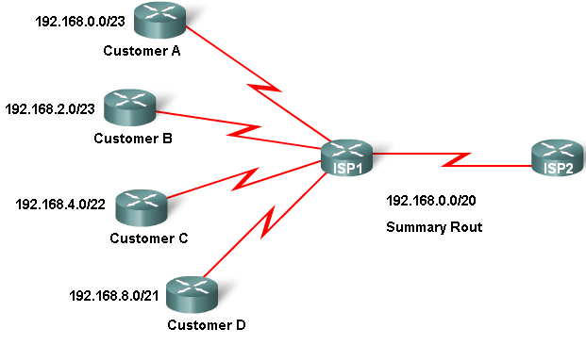
Classful and Classless IP Addressing
Classless IP Addressing
CIDR & Route Summarization
-Variable Length Subnet Masking (VLSM)
-Allows a subnet to be further sub-netted according to individual needs
-Prefix Aggregation a.k.a. Route Summarization
-CIDR allows for routes to be summarized as a single route

Slide 13
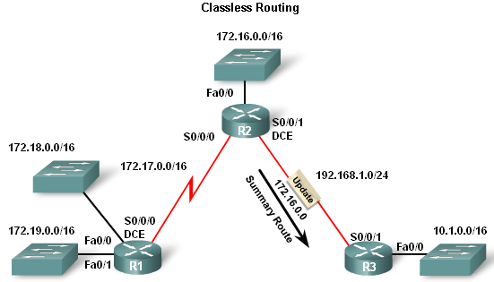
Classful and Classless IP Addressing
Classless Routing Protocol
Characteristics of classless routing protocols:
-Routing updates include the subnet mask
-Supports VLSM
Supports Route Summarization

Slide 14
Classful and Classless IP Addressing
Classless Routing Protocol
Routing Protocol | Routing updates Include subnet Mask | Supports VLSM | Ability to send Supernet routes
Classful | No | No | No
Classless | Yes | Yes | Yes

Slide 15
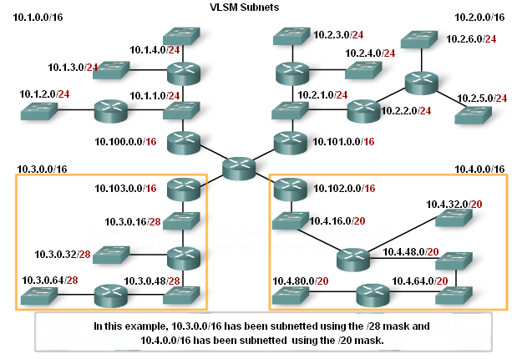
VLSM
Classful routing
  -only allows for one subnet mask for all networks
VLSM & classless routing
-This is the process of subnetting a subnet
-More than one subnet mask can be used
-More efficient use of IP addresses as compared to classful IP addressing

Slide 16
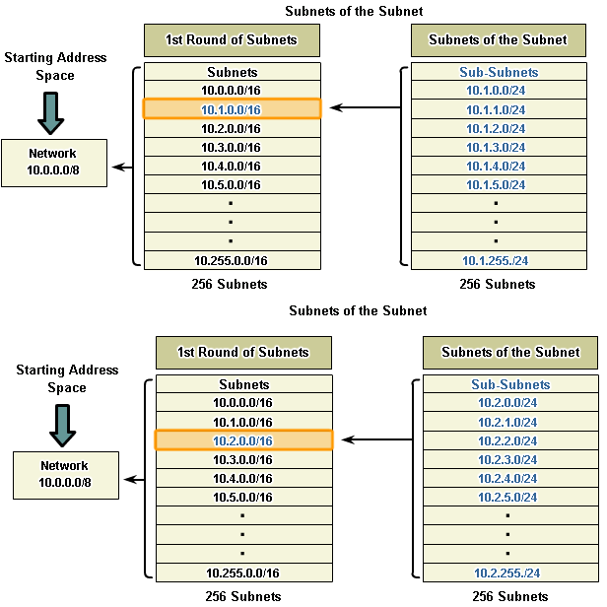
VLSM
VLSM – the process of sub-netting a subnet to fit your needs
-Example:
Subnet 10.1.0.0/16, 8 more bits are borrowed again, to create 256 subnets with a /24 mask.
-Mask allows for 254 host addresses per subnet
-Subnets range from: 10.1.0.0 / 24 to 10.1.255.0 / 24

Slide 17
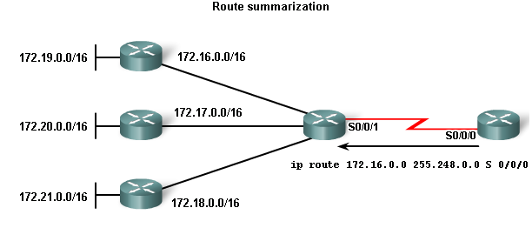
Classless Inter-Domain Routing (CIDR)
Route summarization done by CIDR
-Routes are summarized with masks that are less than that of the default classful mask
-Example:
172.16.0.0 / 13 is the summarized route for the 172.16.0.0 / 16 to 172.23.0.0 / 16 classful networks

Slide 18
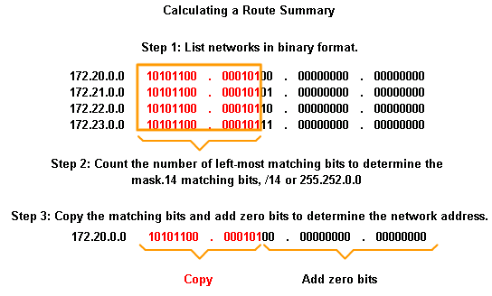
Classless Inter-Domain Routing (CIDR)
Steps to calculate a route summary
-List networks in binary format
-Count number of left most matching bits to determine summary route’s mask
-Copy the matching bits and add zero bits to determine the summarized network address

Slide 19
Summary
Classful IP addressing
  IPv4 addresses have 2 parts:
        -Network portion found on left side of an IP address
        -Host portion found on right side of an IP address
  Class A, B, & C addresses were designed to provide IP addresses for different sized organizations
  The class of an IP address is determined by the decimal value found in the 1st octet
  IP addresses are running out so the use of Classless Inter Domain Routing (CIDR) and Variable Length Subnet Mask (VLSM) are used to try and conserve address space

Slide 20
Summary
Classful Routing Updates
  Subnet masks are not sent in routing updates
Classless IP addressing
  Benefit of classless IP addressing
        Can create additional network addresses using a subnet mask that fits your needs
  Uses Classless Interdomain Routing (CIDR)

Slide 21
Summary
CIDR
  Uses IP addresses more efficiently through use of VLSM
        -VLSM is the process of subnetting a subnet
  Allows for route summarization
        -Route summarization is representing multiple contiguous routes with a single route

Slide 22
Summary
Classless Routing Updates
  Subnet masks are included in updates

